Slide 1

Variable Changes in Attendance at Wrigley Field
2015 – 2019
By: Scott Duncan, Sam Ettenson, Calvin Brown, Tiffany Christmas
Notes:
(Calvin)

Slide 2
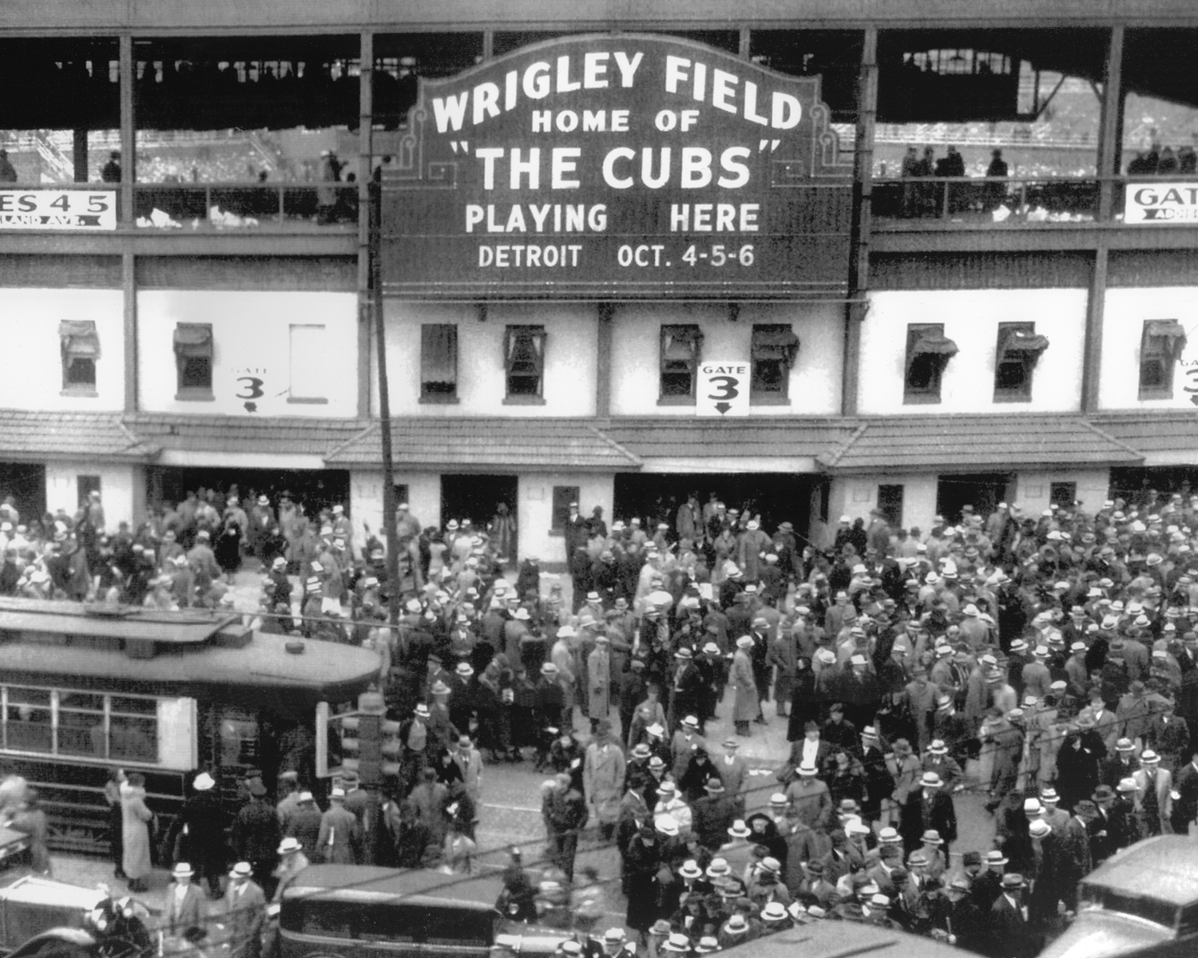
GO CUBS GO!
How is attendance at Wrigley Field affected when considering…
Weather
Home Team Performance
Attendance due to Opponent
Day of the Week, Time of Day, and Year
Notes:
(Calvin)

Slide 3
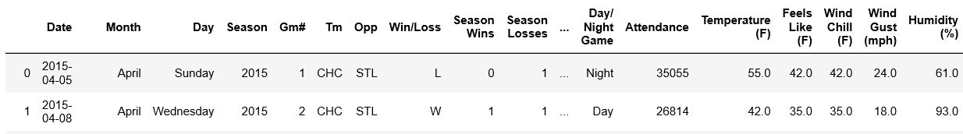
What Data is Needed?
MLB Summary Statistics
Historical Weather Data
Individual attendance Records per Game Date
Day, Month, and Year
Game Season
Opponents
Temperature/Windchill in F
Humidity
Cloud Coverage
Wind Gust
Rainfall
Notes:
(Sam)

Slide 4
Cleaning & Exploring
CSV/Excel for MLB Statistics
Formatting:
Date Order
Column Headers
Delimiting
Separated the Month and Date
Excel Import to Jupyter Notebook
API Call for Historical Weather Data
JSON Format
Changed time interval of calls per day to 24 hour interval only versus 3 hour interval
Pulled Relevant Dictionaries in API to merge into Jupyter Notebook
Merged Data into Jupyter Notebook
Groupby Date
Pulled historical weather data date for MLB Games only
Weather data had 900+ rows of information, only needed 404 data points
Notes:
(Tiffany)

Slide 5
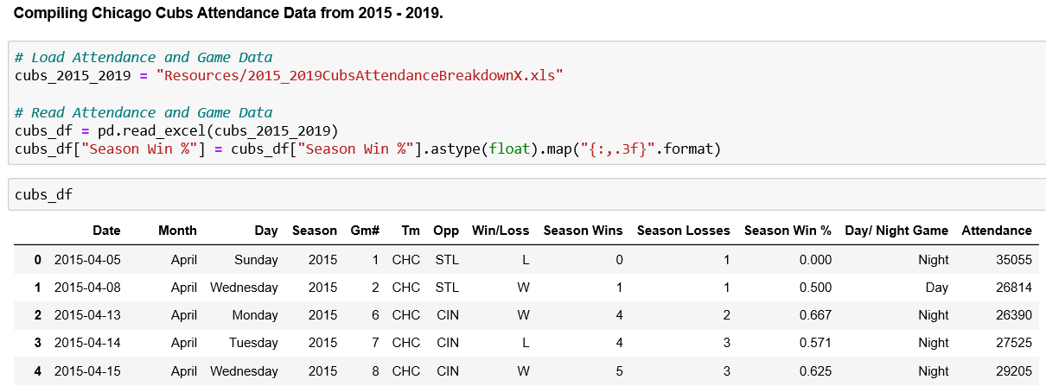
Cleaning & Exploring Cont.

Slide 6
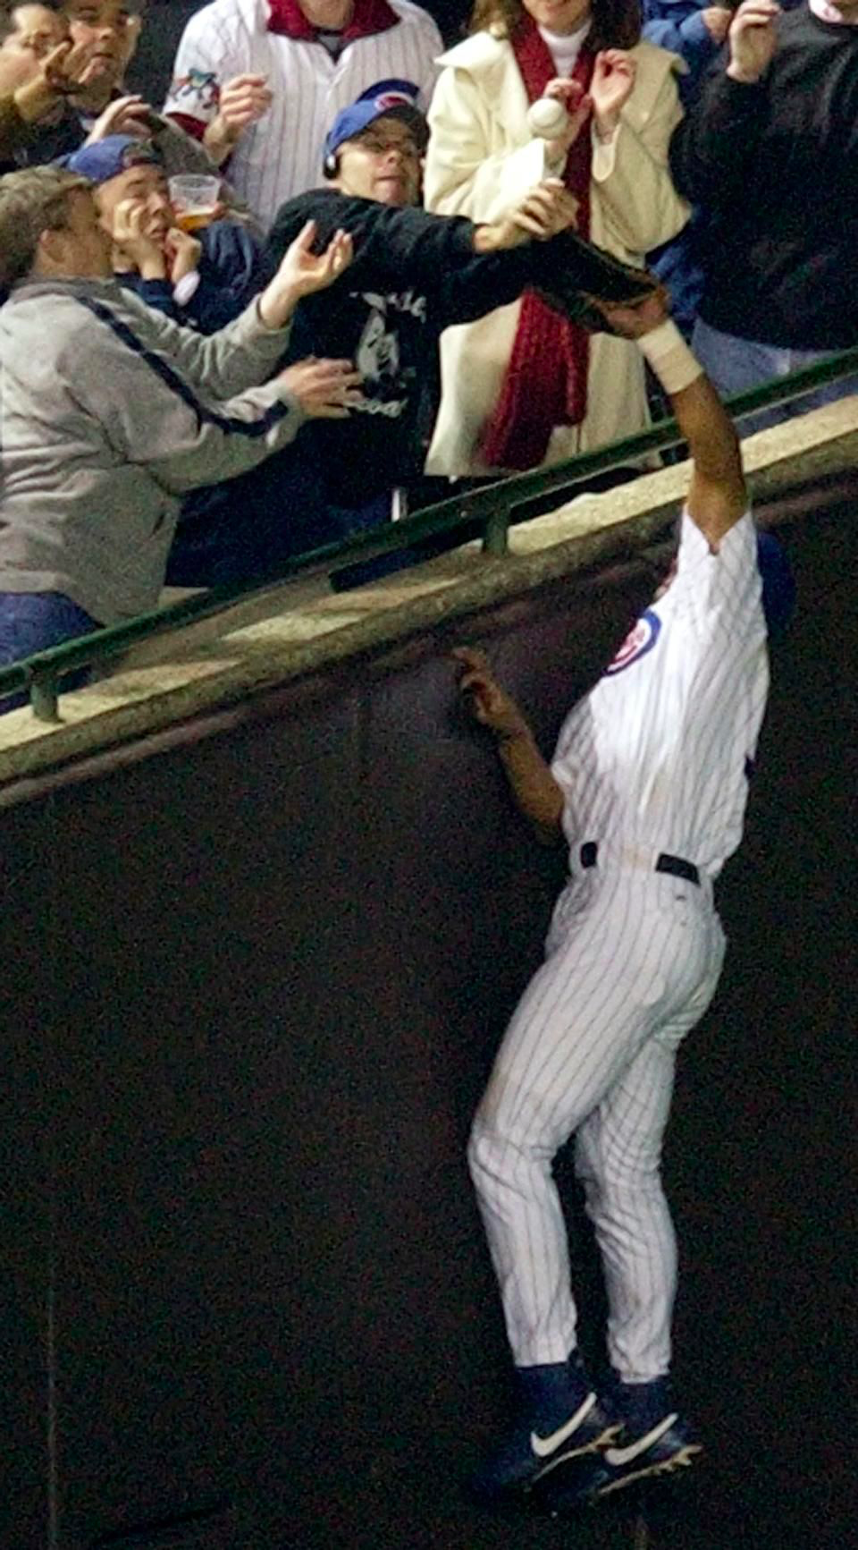
The Bartman Phenomenon
Historical Weather API
Locate free weather API
Each call only pulled an average of 30 days of historical weather data
30 different API calls needed to compile all dates needed
Required to append each individual API call to one inclusive data frame
Reformatted date structure in order to merge API data
MLB Statistics
Locate statistical data on individual attendance for each game from 2015 to 2019 versus average per year attendance
Crime Data
Attempted to perform a crime data comparison to game attendance
Time constraints in presentation of data
Wrigley Field Specific Crimes:
Felonies
Misdemeanors
Exact Locatios
Notes:
(Scott)

Slide 7
“It’s a Bee–yoo–tiful Day”
When weather increases then the average attendance for games will also increase.
How do other factors such as Humidity, Daily Rain Fall, Cloud Cover, Wind Conditions affect attendance?
Attempted to correlate the different weather conditions to temperature and to compare its relationship to attendance
Notes:
Why did you ask these questions?

Slide 8
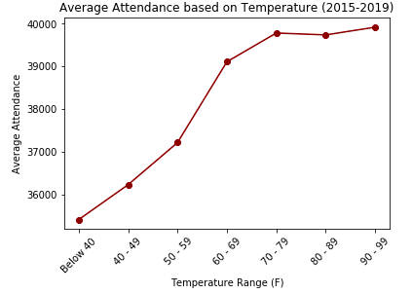
Weather Data Analysis
Notes:
If I had more time on my weather analysis…
Summarize Conclusion: Summary about what the data yielded and visualization

Slide 9
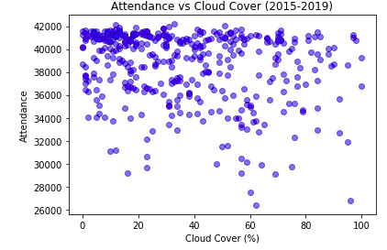
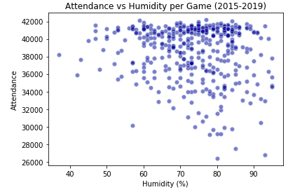
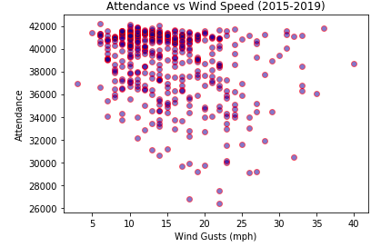
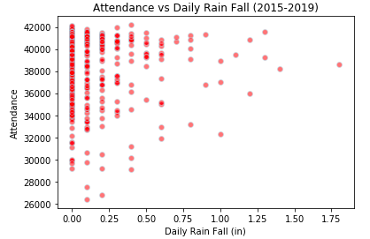

Slide 10
Weather Analysis Summary
With a rise in temperature there was a notable increase in per game attendance with the highest attendance at approximately 90 degrees
We were unable to find statistically significant data to correlate the rise in attendance with temperature to the other weather factors analyzed
With additional project time we would want to measure hourly stats per game instead of average daily status to better understand weather factors

Slide 11
Fly the “W” Every Day
With an increase in win percentage we expect to see an increase in attendance.
How is the closing day attendance change based on the final win/loss record of the Chicago Cubs?
As the Cubs performance improved over time, we would assume that the team would attract more in game attendees

Slide 12
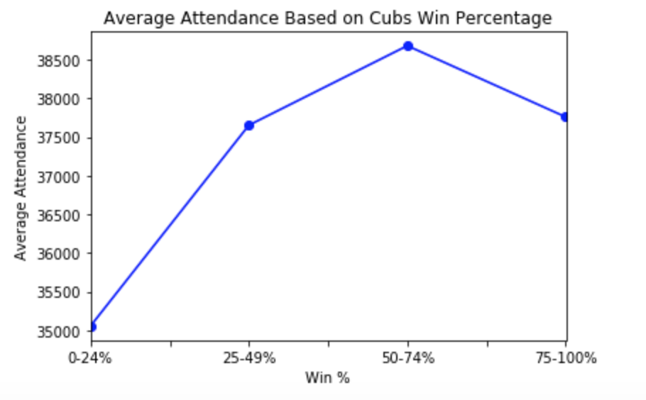
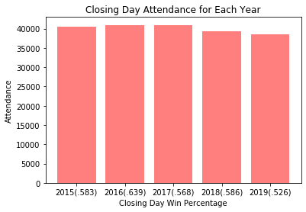
Team Performance Analysis
Notes:
If I had more time on my weather analysis:

Slide 13
Team Performance Summary
There is a slight correlation with increased attendees as the Cubs performance was over .500
An attendee plateau occurred at approximately .740
It would be interesting to look further into past performance records prior to 2015 in order to compare attendance during very low performance years
Notes:
- The capacity of Wrigley Field is 4,649

Slide 14
Cubs Win! Cubs Win!
The highest attending games would be rival teams, featuring the St. Louis Cardinals and the Chicago White Sox
What affect does an opponent team playing at Wrigley Field have on in person attendance?
Sought to correlate the visiting team’s impact on attendance at Wrigley Field in comparison to one another

Slide 15
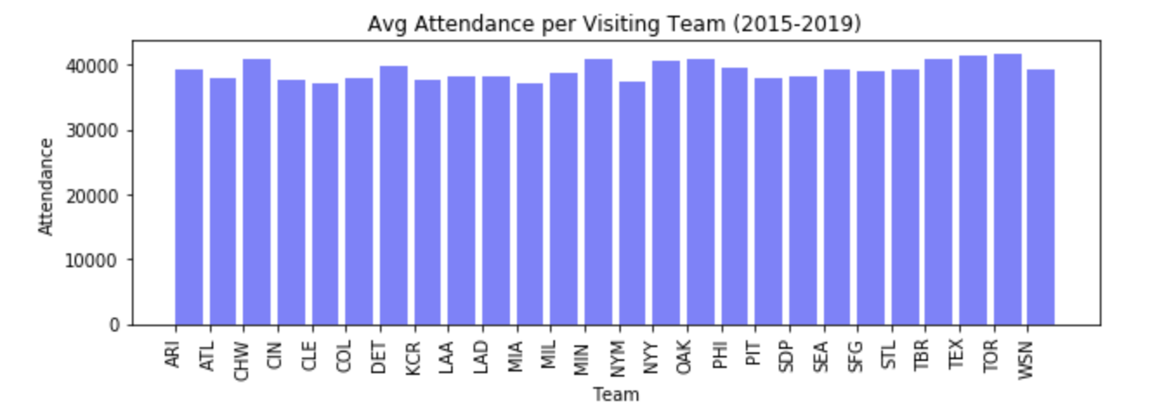
Opponent Attendance Data Analysis
Notes:
If I had more time on my weather analysis:

Slide 16
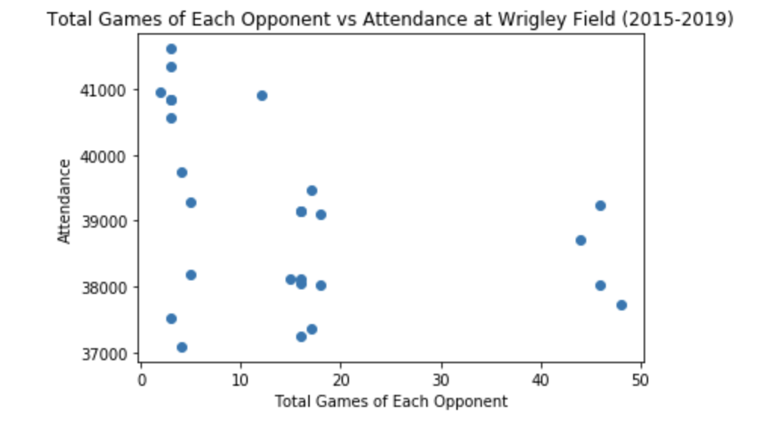

Slide 17
Cubs Show Up Day or Night
The night and weekend games have increased attendance due to attendee availability and convenience
Is there a correlation to in person attendance based on the days of the week?
Does the time of day impact the attendance at Wrigley Field?

Slide 18
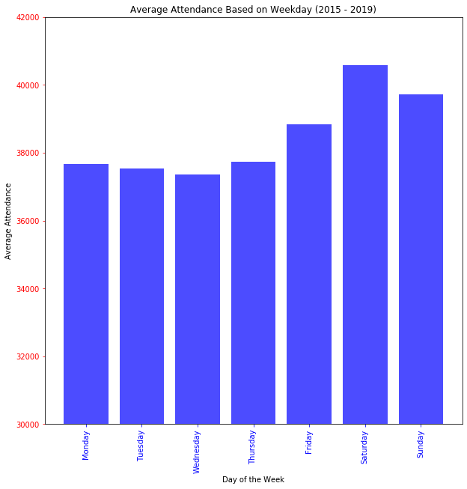

Slide 19
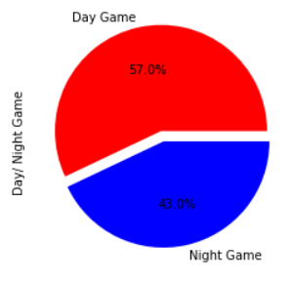
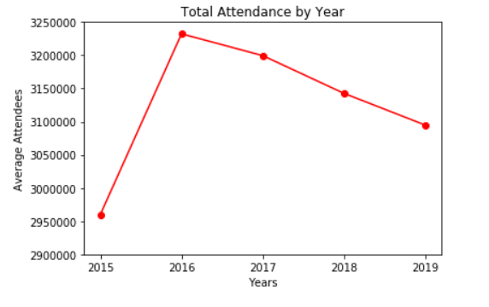

Slide 20
Attendance Based on Day and Year Analysis
The highest average game attendance occurs on the weekend and specifically peaks on Saturday
Cubs games have more games in the morning possibly contributing to the non domed type of field
The highest game attendance peaked in 2016 and has steadily decreased year over year
It would be interesting to see if their total attendance would increase with more night game opportunities
Notes:
If I had more time on my weather analysis:

Slide 21
CUBS WIN
Questions?

Slide 22
References
MLB Statistics for Chicago Cubs
https://www.baseball-reference.com/teams/CHC/2019-schedule-scores.shtml
Historical Weather Data API
https://www.worldweatheronline.com

